Slide 1
Chapter 11
How to use jQuery plugins and UI widgets

Slide 2
Objectives (part 1)
Applied
Use jQuery plugins and UI widgets in your applications.
Knowledge
In general terms, describe a jQuery plugin.
In general terms, describe the process of finding and using a plugin.
From the website user’s point of view, describe the operation of any of these plugins: Lightbox, bxSlider, or Cycle 2.
In general terms, describe a jQuery UI widget.
Describe the files and folders that jQuery UI requires, and explain how to include them in your web pages.

Slide 3
Objectives (part 2)
In general terms, describe the process of finding and using a jQuery UI widget.
From the website user’s point of view, describe the operation of any of these jQuery UI widgets: Accordion, Tabs, Button, Dialog, or Datepicker.

Slide 4
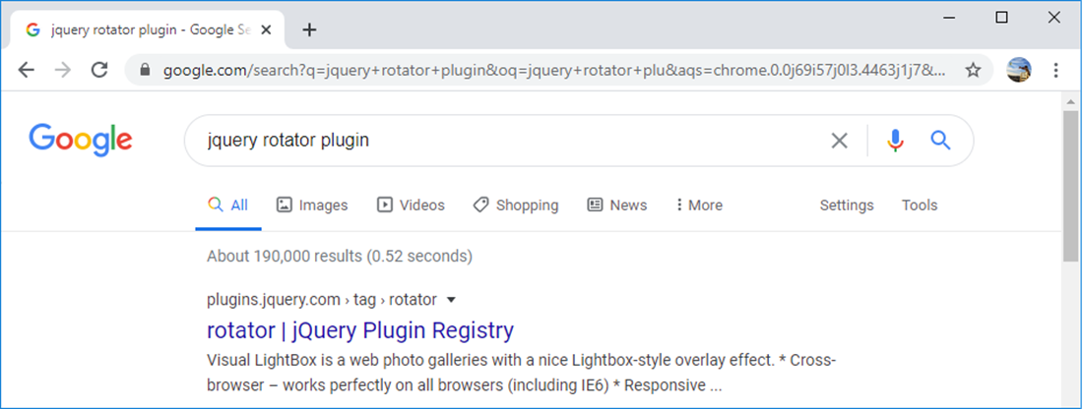
A Google search for a jQuery plugin

Slide 5
Websites for finding jQuery plugins
Site name URL
jQuery Plugin Registry https://plugins.jquery.com
Google Code https://code.google.com
GitHub https://github.com
Sourceforge https://sourceforge.net

Slide 6
Popular plugins for displaying images
Site name URL
Lightbox https://lokeshdhakar.com/projects/lightbox2
Fancybox https://fancyapps.com
ThickBox http://codylindley.com/thickbox
ColorBox https://www.jacklmoore.com/colorbox
Popular plugins for slide shows and carousels
Site name URL
bxSlider https://bxslider.com
Malsup jQuery Cycle 2 http://jquery.malsup.com/cycle2
jCarousel https://sorgalla.com/jcarousel
A popular plugin for data validation
Site name URL
jQuery Validation https://jqueryvalidation.org/

Slide 7
General steps for using a plugin within your web pages
Study the documentation for the plugin.
Get the URLs for the plugin files if they’re available via a CDN, or download the files and save them in one of the folders of your website.
In the head element of the HTML, code the link elements for any CSS files that are required.
At the end of the body element, code the script elements for the JavaScript files that are required.
If the download for a plugin includes an images folder, make sure the folder has the right structural relationship with both the CSS and JavaScript files for the plugin.
Code the HTML and CSS for the page so it’s appropriate for the plugin.
If necessary, write the JavaScript and jQuery code that uses the methods and options of the plugin.

Slide 8
Two cautions when using plugins
Make sure to include a script element for jQuery before the script element for the plugin.
Some plugins don’t work with the latest version of jQuery. So if you have problems with a plugin, check its documentation to see which versions of jQuery it supports.

Slide 9
The script elements for the jQuery library and the bxSlider plugin
<script
src="https://code.jquery.com/jquery-3.1.1.min.js">
</script>
<script src="js/jquery.bxSlider.min.js"></script>

Slide 10
The HTML for a bxSlider plugin
<ul id="slider">
<li><img src="images/building_01.jpg" alt=""
title="Front"></li>
<li><img src="images/building_02.jpg" alt=""
title="Left side"></li>
...
</ul>

Slide 11
The JavaScript and jQuery for the bxSlider plugin
$(document).ready( ()=>
$("#slider").bxSlider({
minSlides: 2,
maxSlides: 2,
slideWidth: 250,
slideMargin: 10
})
)

Slide 12
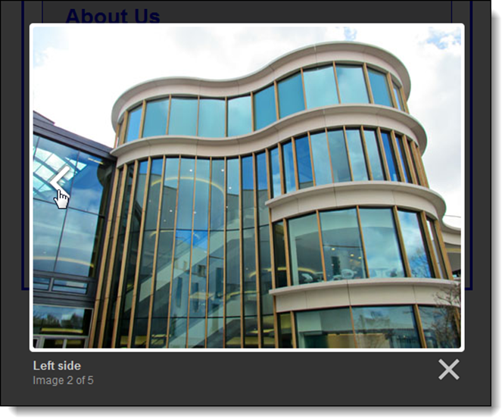
A Lightbox plugin

Slide 13
The URL for the Lightbox website
https://lokeshdhakar.com/projects/lightbox2/
The link and script elements for the Lightbox plugin
<link href="styles.css" rel="stylesheet">
<link href="css/lightbox.css" rel="stylesheet">
<script
src="https://code.jquery.com/jquery-3.4.1.min.js">
</script>
<script src="js/lightbox.min.js"></script>

Slide 14
The HTML for the images used by the Lightbox plugin
<a href="images/building_01.jpg" data-lightbox="vecta"
data-title="Front">
<img src="images/building_01_thumb.jpg" alt=""></a>
<a href="images/building_02.jpg" data-lightbox="vecta"
data-title="Left side">
<img src="images/building_02_thumb.jpg" alt=""></a>
...

Slide 15
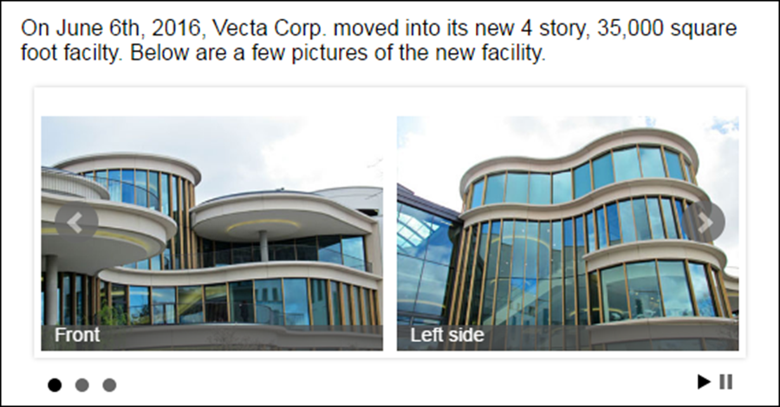
A bxSlider plugin for a carousel

Slide 16
The URL for the bxSlider website
https://bxslider.com
The link and script elements for the bxSlider plugin
<link href="styles.css" rel="stylesheet">
<link href="jquery.bxslider.css" rel="stylesheet">
<script
src="https://code.jquery.com/jquery-3.1.1.min.js">
</script>
<script src="js/jquery.bxSlider.min.js">

Slide 17
The HTML for the bxSlider plugin
<ul id="slider">
<li><img src="images/building_01.jpg" alt=""
title="Front"></li>
<li><img src="images/building_02.jpg" alt=""
title="Left side"></li>
...
</ul>

Slide 18
The JavaScript and jQuery for using some of the bxSlider options
$(document).ready( () =>
$("#slider").bxSlider({
auto: true,
autoControls: true,
captions: true,
minSlides: 2,
maxSlides: 2,
slideWidth: 250,
slideMargin: 10
})
)

Slide 19
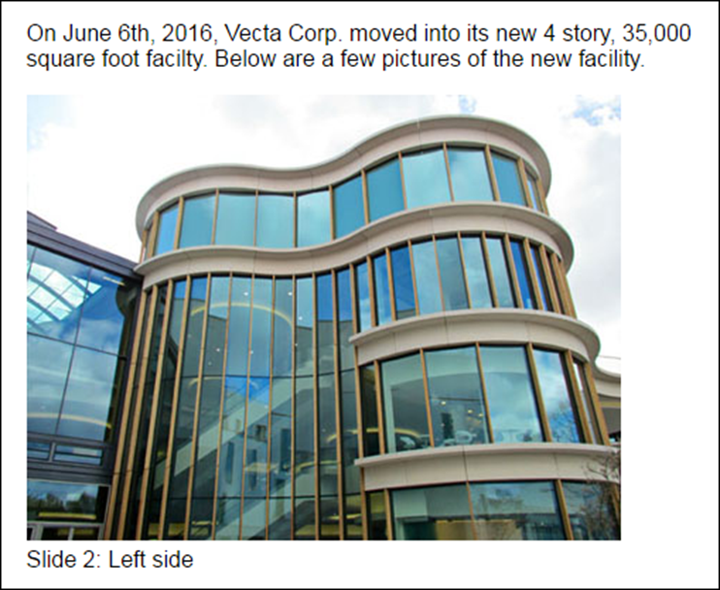
A Cycle 2 plugin for a slide show

Slide 20
The URL for the Cycle 2 website
http://jquery.malsup.com/cycle2/
The script elements for the Cycle 2 plugin
<script
src="https://code.jquery.com/jquery-3.4.1.min.js">
</script>
<script src="https://malsup.github.com/jquery.cycle2.js">
</script>

Slide 21
The HTML for the Cycle 2 plugin
<div class="cycle-slideshow"
data-cycle-fx="scrollHorz"
data-cycle-timeout="2000"
data-cycle-caption="#adv-custom-caption"
data-cycle-caption-template=
"Slide {{slideNum}}: {{cycleTitle}}" >
<img src="images/building_01.jpg" alt=""
data-cycle-title="Front">
<img src="images/building_02.jpg" alt=""
data-cycle-title="Left side">
...
<!-- empty element for caption -->
<div id="adv-custom-caption"></div>
</div>

Slide 22
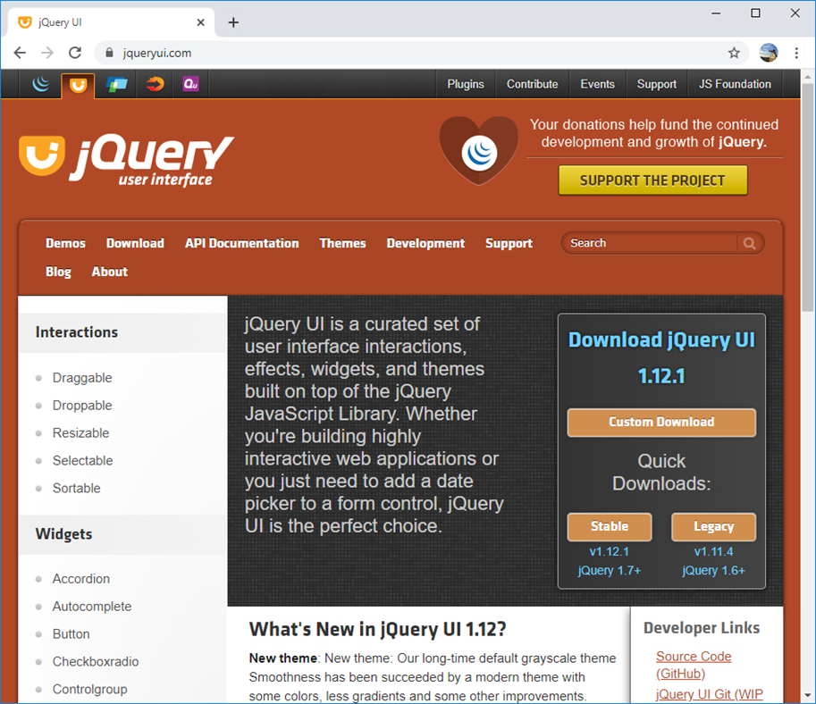
The jQuery UI website

Slide 23
The URL for jQuery UI
https://jqueryui.com/
The four types of features provided by jQuery UI
Widgets
Themes
Interactions
Effects

Slide 24
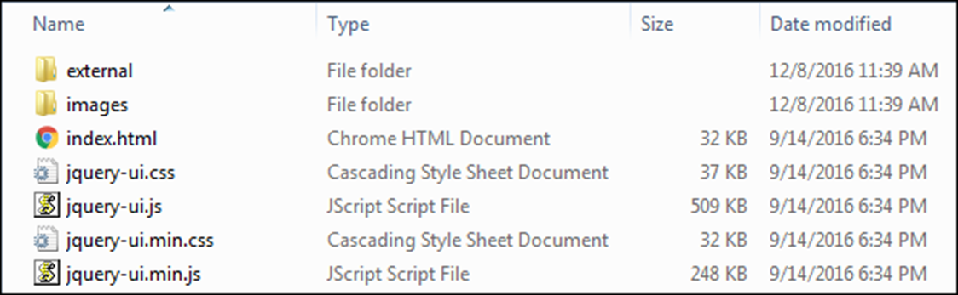
The primary folders and files in a full jQuery UI download

Slide 25
How to build a jQuery UI download
From the home page, click the Download link in the navigation bar or the Custom Download button. That should navigate to the Download Builder page.
Select or deselect the interactions, widgets, and effects until the checked boxes identify the components that you want in your download.
To select a theme for the download, use the drop-down list at the bottom of the page. To build a custom theme, click on the link above the list.
Click the Download button to download a zipped folder that contains the jQuery UI files.

Slide 26
How to include the downloaded files in your application
<!-- link elements for the jQuery UI stylesheets -->
<link rel="stylesheet"
href="/jquery-ui-1.12.1/jquery-ui.min.css">
<!-- the script elements for jQuery and jQuery UI -->
<script
src="https://code.jquery.com/jquery-3.4.1.min.js">
</script>
<script src="/jquery-ui-1.12.1/jquery-ui.min.js">
</script>
<!-- the script element for your external JavaScript file or your code -->
<script src="..."></script>

Slide 27
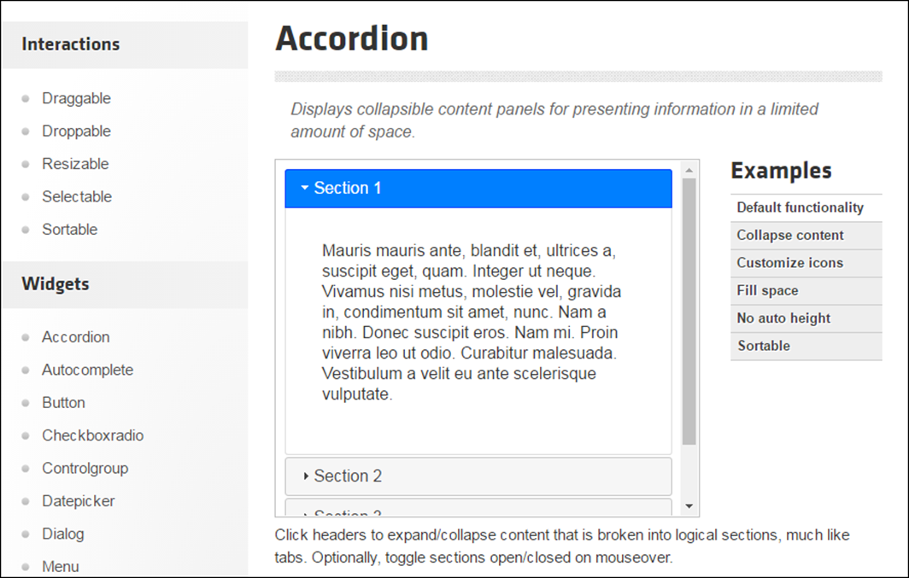
The accordion documentation

Slide 28
How to use the jQuery UI documentation
In the left sidebar, click on a widget name to display its documentation.
In the right sidebar, click on an example name to see a working example, then click on the View Source link to see the code for the example.
Click the API Documentation link to display information about the widget’s options, methods, and events.

Slide 29
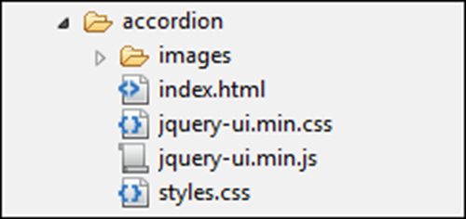
The images folder and jquery-ui.min.css relationship that jQuery UI expects

Slide 30
The JavaScript and jQuery for using a widget
$(document).ready( () =>
$("selector").widgetMethod({
// option settings
})
)

Slide 31
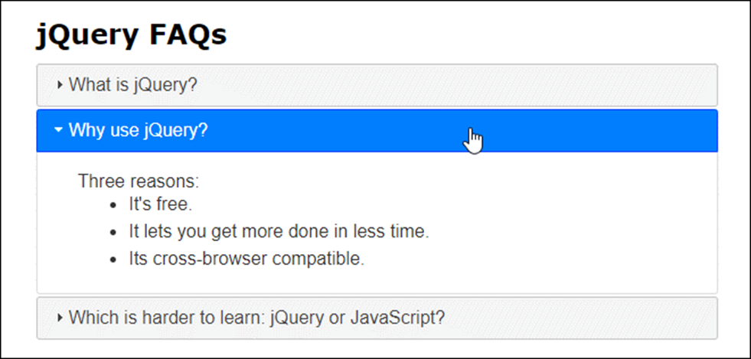
An Accordion widget

Slide 32
The HTML for the accordion
<div id="accordion">
<h3>What is jQuery?</h3>
<div><!-- the content for the panel --></div>
<h3>Why use jQuery?</h3>
<div><!-- the content for the panel --></div>
<h3>Which is harder to learn: jQuery or
JavaScript?</h3>
<div><!-- the content for the panel --></div>
</div>

Slide 33
The JavaScript and jQuery for the accordion
$(document).ready( () =>
$("#accordion").accordion({
event: "mouseover",
heightStyle: "content",
collapsible: true
})
)

Slide 34
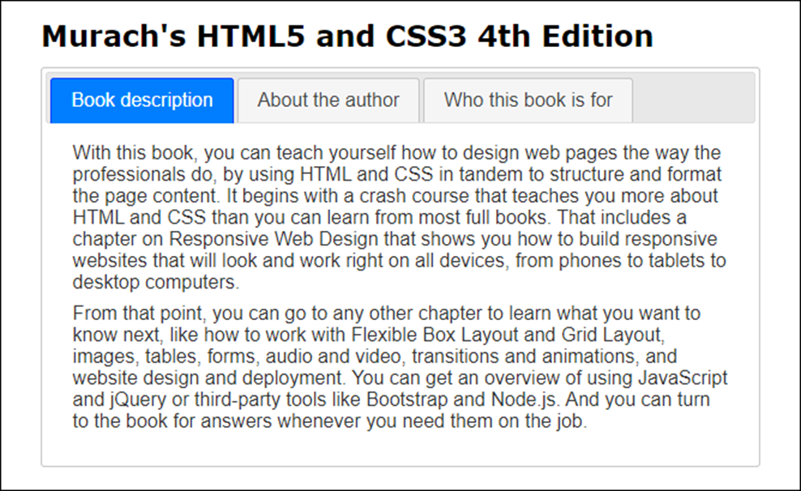
A Tabs widget

Slide 35
The HTML for the tabs
<div id="tabs">
<ul>
<li><a href="#tabs-1">Book description</a></li>
<li><a href="#tabs-2">About the author</a></li>
<li><a href="#tabs-3">Who this book is for</a>
</li>
</ul>
<div id="tabs-1"><!-- the content --></div>
<div id="tabs-2"><!-- the content --></div>
<div id="tabs-3"><!-- the content --></div>
</div>

Slide 36
The JavaScript and jQuery for the tabs
$(document).ready( () =>
$("#tabs").tabs()
)

Slide 37
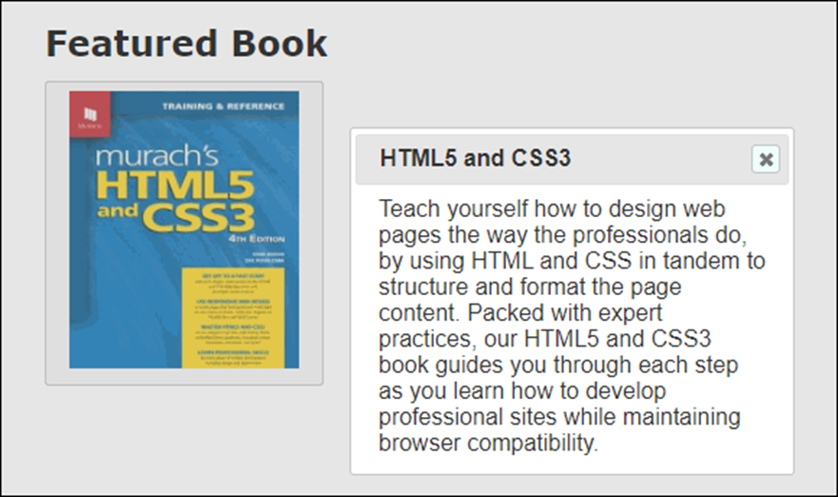
A Button widget that activates a Dialog widget

Slide 38
The HTML for the Button and Dialog widgets
<a id="book"><img src="images/4HTM.jpg"
alt="HTML5 and CSS3 book"/></a>
<div id="dialog" title="HTML5 and CSS3"
style="display:none;">
<!-- the contents for the dialog box -->
</div>

Slide 39
The JavaScript and jQuery for the Button and Dialog widgets
$(document).ready( () => {
$("#book").button();
$("#book").click( () =>
$("#dialog").dialog({
modal:true
})
);
})

Slide 40
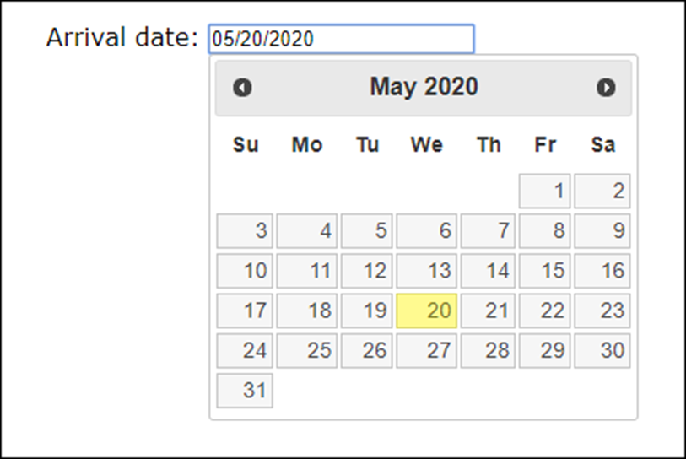
A Datepicker widget with no options set

Slide 41
The HTML for the Datepicker widget
<label>Arrival date:</label>
<label><input type="text" id="datepicker"></label>

Slide 42
The JavaScript and jQuery for the Datepicker widget
With no options
$(document).ready( () =>
$("#datepicker").datepicker()
)
With three options
$(document).ready( () =>
$("#datepicker").datepicker({
minDate: new Date(),
maxDate: +45,
showButtonPanel: true
})
)

